Slide 1
Algorithms Lecture 4
Module Leader : Dr. Mostafa Salama
Module Code: Analysis of Algorithms
Module Code: 16CSCI01I
Module Aim:
Analyse the amount of resources needed to solve a given computational problem.
Compare the efficiency of using different algorithms in addressing and solving the problem.
Module Content:
Principles of Algorithm Analysis [Brute Force algorithms]
Greedy Algorithms.
Divide and Conquer Algorithms.
Dynamic Programming Algorithms.
Genetic algorithms
Module Evaluation:
Assignment :20%, deliver in Sunday week 5
Class Test :30%, on week 7
Final Exam :50%
Lecture notes : 2

Slide 2
Dynamic programming [Definitions]
Dynamic programing paradigm defined by recurrences with overlapping sub-instances. Programming here means “planning” as it refers to a tabular method.
Main idea:
The algorithm set up a recurrence relation between a solution of a larger instance and solutions of some smaller instances.
Then records smaller solution of smaller instances once in a table.
Then extracts solution to the initial instance from that table.
Dynamic programming is a way of improving on inefficient divide-and-conquer algorithms.
By “inefficient”, we mean that the same recursive call is made over and over.
If same subproblem is solved several times, we can use table to store result of a subproblem the first time it is computed and thus never have to recompute it again.
Dynamic programming is applicable when the sub-problems are dependent, that is, when sub-problems share sub-sub-problems.
Example:
knapsack Problem
Longest common subsequence
Dijkstra Shortest path

Slide 3
DP [knapsack Problem]
Knapsack problem is to find the most valuable subset of the items that fit into the knapsack such that:
A number of n items of known weights w₁, w₂, . . . , w_{n}
Values v₁, v₂, . . . , v_{n}
A knapsack of a weight capacity W
In other words, find a set of items that maximizes ∑v while ∑w is less than W.
Algorithm knapsack(w[1..n], v[1..n], W) //The function complexity is F(n,W)=O(nW)
Input sequences w and v with n elements
Output Table V[n, W]
for j = 0 to W // Complexity W
V[0, j] = 0
for i = 0 to n // Complexity n
V[i, 0] = 0
for i = 1 to n //
for j = 1 to W // Complexity nW
if (w[i] ≤ j) &&
( v[i] + V[i -1, j-w[i]] > V[i-1, j] )
V[i, j] = v[i] + V[i-1, j-w[i]];
P[i, j] = j - w[i]
else
V[i, j] = V[i-1,j];
P[i, j] = j
Complexity of this algorithm is :
n+W+nW = O(nW)
Knapsack of capacity W = 5
item (w)eight (v)alue
1 2 $12
2 1 $10
3 3 $20
4 2 $15
j
W
i
V | 0 | 1 | 2 | 3 | 4 | 5
0 | 0 | 0 | 0 | 0 | 0 | 0
1 | 0 | 0 | 12
2 | 0 | 10 | 12 | 22 | 22 | 22
3 | 0 | 10 | 12 | 22 | 30 | 32
4 | 0 | 10 | 15 | 25 | 30 | 37
P=0
P=2
P=3
n
P=3

Slide 4
DP [knapsack Problem]
The classic dynamic programming approach works in a bottom-up methodology. It fills a table with solutions to all smaller sub-problems, but each of them is solved only once.
The composition of an optimal subset is extracted by backtracking the computations in the table P extracted from the knapsack algorithm.
Algorithm knapsack-backtracking (P[n, W]) //The function complexity is F(n)=n
Input P[n, W] describes the remaining number of items after testing this current item
Output Optimal set of items suitable for the knapsack
set j = W; // starting from item [i=n,j=W] bottom of the table P
for i = n to 0 // Complexity is n
if P[i, j] = j
item i is not selected where the remaining
number of items to be selected will not be
affected after testing this item
else
item i is selected and added to optimal set
set j = P[i, j]
j
W
i
V | 0 | 1 | 2 | 3 | 4 | 5
0 | 0 | 0 | 0 | 0 | 0 | 0
1 | 0 | 0 | 12
2 | 0 | 10 | 12 | 22 | 22 | 22
3 | 0 | 10 | 12 | 22 | 30 | 32
4 | 0 | 10 | 15 | 25 | 30 | 37
P=0
P=2
P=3
n
P=3

Slide 5
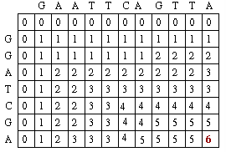

DP [LCS Problem]
Longest Common Subsequence problem : Example :
Given S₁ = GAATTCAGTTA of length n, and S₂ = GGATCGA of length m
Find longest common subsequence S= GATCGA
Algorithm LCS(S₁ , S₂) //The function complexity is represented by F(n,m)=nm
Input sequences S₁ and S₂ of length n and m respectively
Output Longest Common subsequence S
V: Score Matrix (2 dimensional n x m), P: Direction Matrix (2 dimensional n x m)
for i = 0 to n //
for j = 0 to m // Complexity nm
if (i=0||j=0)
V[i, j]=0
else if (S₁[i]== S₂[j])
V(i,j)=V[i-1,j-1]+1; P(i,j) =  ;
else if (V[i-1,j] >= V[i,j-1]
V(i,j)= V[i-1,j]; P(i,j) = ⬇ ;
else
V(i,j)= V[i,j-1] ; P(i,j) = ➔ ;

Slide 6
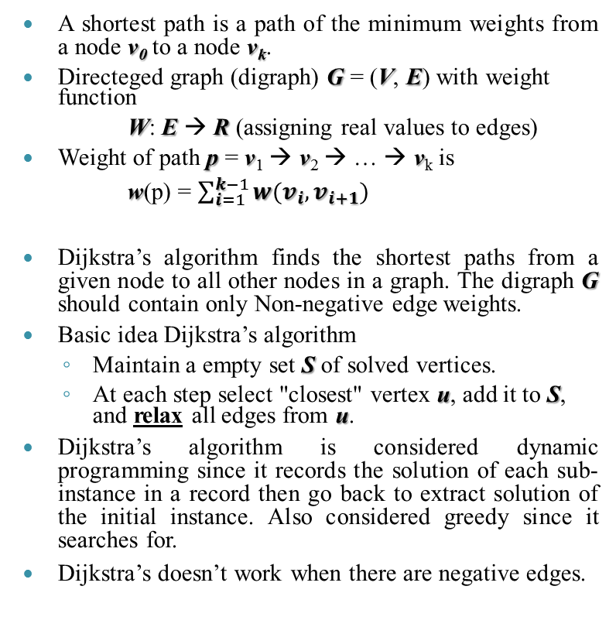
Dynamic programming [Dijkstra SP]
A shortest path is a path of the minimum weights from a node v₀ to a node v_{k}.
Directeged graph (digraph) G = (V, E) with weight function
W: E → R (assigning real values to edges)
Weight of path p = v₁ → v₂ → … → v_{k} is
w(p) = $\sum_{i=1}^{k−1}{w(v_{i},v_{i+1})}$
Dijkstra’s algorithm finds the shortest paths from a given node to all other nodes in a graph. The digraph G should contain only Non-negative edge weights.
Basic idea Dijkstra’s algorithm
Maintain a empty set S of solved vertices.
At each step select "closest" vertex u, add it to S, and relax all edges from u.
Dijkstra’s algorithm is considered dynamic programming since it records the solution of each sub-instance in a record then go back to extract solution of the initial instance. Also considered greedy since it searches for.
Dijkstra’s doesn’t work when there are negative edges.
v₄
2.5
1
2
v_{k}
2
v₃
1.5
v₅
0.5
3
2
v₁
4
1
v₂
6
3
4
v₀

Slide 7
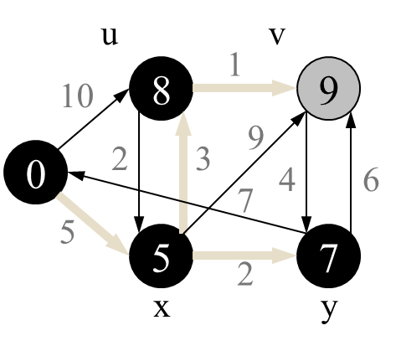
D. p. [Dijkstra SP]
u
1
v
10
∞
∞
s
0
2
3
9
7
4
6
source = s
5
∞
∞
s><Q
x
2
y
v | d | p
s | 0 | -1
u | 10 | s
v | ∞ | -1
x | 5 | s
y | ∞ | -1
u
1
v
10
10
∞
v | d | p
s | 0 | -1
u | ∞ | -1
v | ∞ | -1
x | ∞ | -1
y | ∞ | -1
function Dijkstra(Graph, source):
Create an empty vertex set Q
for each vertex v in Graph: // Initialization
d [k] ← ∞ // Unknown distance from source to k
p [k] ← -1 // Previous node in optimal path from source
add k to Q // All nodes initially in Q (unvisited nodes)
d [source] ← 0 // Distance from source to source
while Q is not empty:
w ← vertex in Q with min d [w] // Source node is selected first
Remove w from Q
for each neighbor k of w: // where v is still in Q.
a ← d [w] + length(w, k)
if (a < d [k] ): // A shorter path to v has been found
d [k] ← a
p [k] ← w
return d[], p[]
s
0
2
3
9
7
4
6
5
5
∞
x
2
y
v | d | P
s | 0 | -1
u | 8 | x
v | 14 | x
x | 5 | s
y | 7 | x
x><Q
u
v
10
8
1
14
s
0
2
3
9
7
4
6
5
5
7
x
2
y
Greedy step
y><Q
v | d | P
s | 0 | -1
u | 8 | x
v | 13 | y
x | 5 | s
y | 7 | x
u
1
v
10
8
13
s
0
2
3
9
4
6
Dijkstra
5
7
5
2
7
x
y
Relaxing
v | d | P
s | 0 | -1
u | 8 | x
v | 9 | u
x | 5 | s
y | 7 | x
u><Q
Dynamic P. step
v | d | P
s | 0 | -1
u | 8 | x
v | 9 | u
x | 5 | s
y | 7 | x
S ← empty sequence
u ← target
while prev[u] is defined:
insert u at the beginning of S
u ← prev[u]
insert u at the beginning of S
u
1
v
v><Q
8
9
v | d | P
s | 0 | -1
u | 8 | x
v | 9 | u
x | 5 | s
y | 7 | x
10
0
2
3
9
7
4
6
5
5
7
x
2
y

Slide 8
Algorithms Lecture 4
To Do in Lab 4
Implement the LCS algorithm using c++ language
Use a counter to determine the number of steps
Compare between the values of this counter in two cases
The input array is already sorted
The input array is reversely sorted

